Slide 1
Efficient Neural Architecture Search via Parameter Sharing
Pattern Recognition & Machine Learning Laboratory
Sangho Kim
Aug 12, 2021

Slide 2
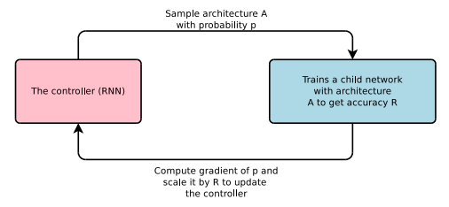
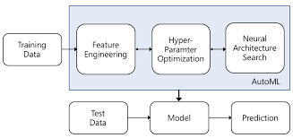
Introduction
Automated Machine Learning (AutoML)
The process of automating the process of applying machine learning
Feature engineering
Hyper-parameter optimization
Neural Architecture Search (NAS)
Neural Architecture Search
Neural Architecture Search with Reinforcement Learning [Zoph et al., 2017]
The controller of the NAS uses the RNN to make sample architecture
Learning the child network to extract accuracy for the validation set
Using validation accuracy like a reward for reinforcement learning
Learning the controller to maximize accuracy
Representative fields of AutoML
Simple NAS structure
B. Zoph and Q. Le, “Neural architecture search with reinforcement learning," ICLR, 2017.

Slide 3
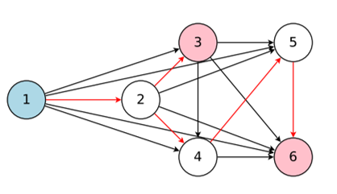
Efficient Neural Architecture Search via Parameter Sharing [H. Pham, et al., 2018]
Goal
Improve the computational complexity of NAS
Improve the processing time of NAS
Motivation
NAS uses 450 GPUs for 4 days
Computational bottleneck of NAS is the training of each child model
Throwing away all the trained weights
NAS’s search space can be represented in directed acyclic graph (DAG)
Nodes are local computation
Edges are information flow
The whole DAG means entire search space
The red arrows are sub-graph
Contributions
Efficient Neural Architecture Search (ENAS) forces all child models to share weights
Using single GPU, the search for architectures takes less than 16 hours
Compared to NAS, time reduction is more than 1000 times
Directed acyclic graph
H. Pham, M. Guan, B. Zoph, Q. Le and J. Dean, “Efficient Neural Architecture Search via Parameter Sharing," CLR, 2018.

Slide 4
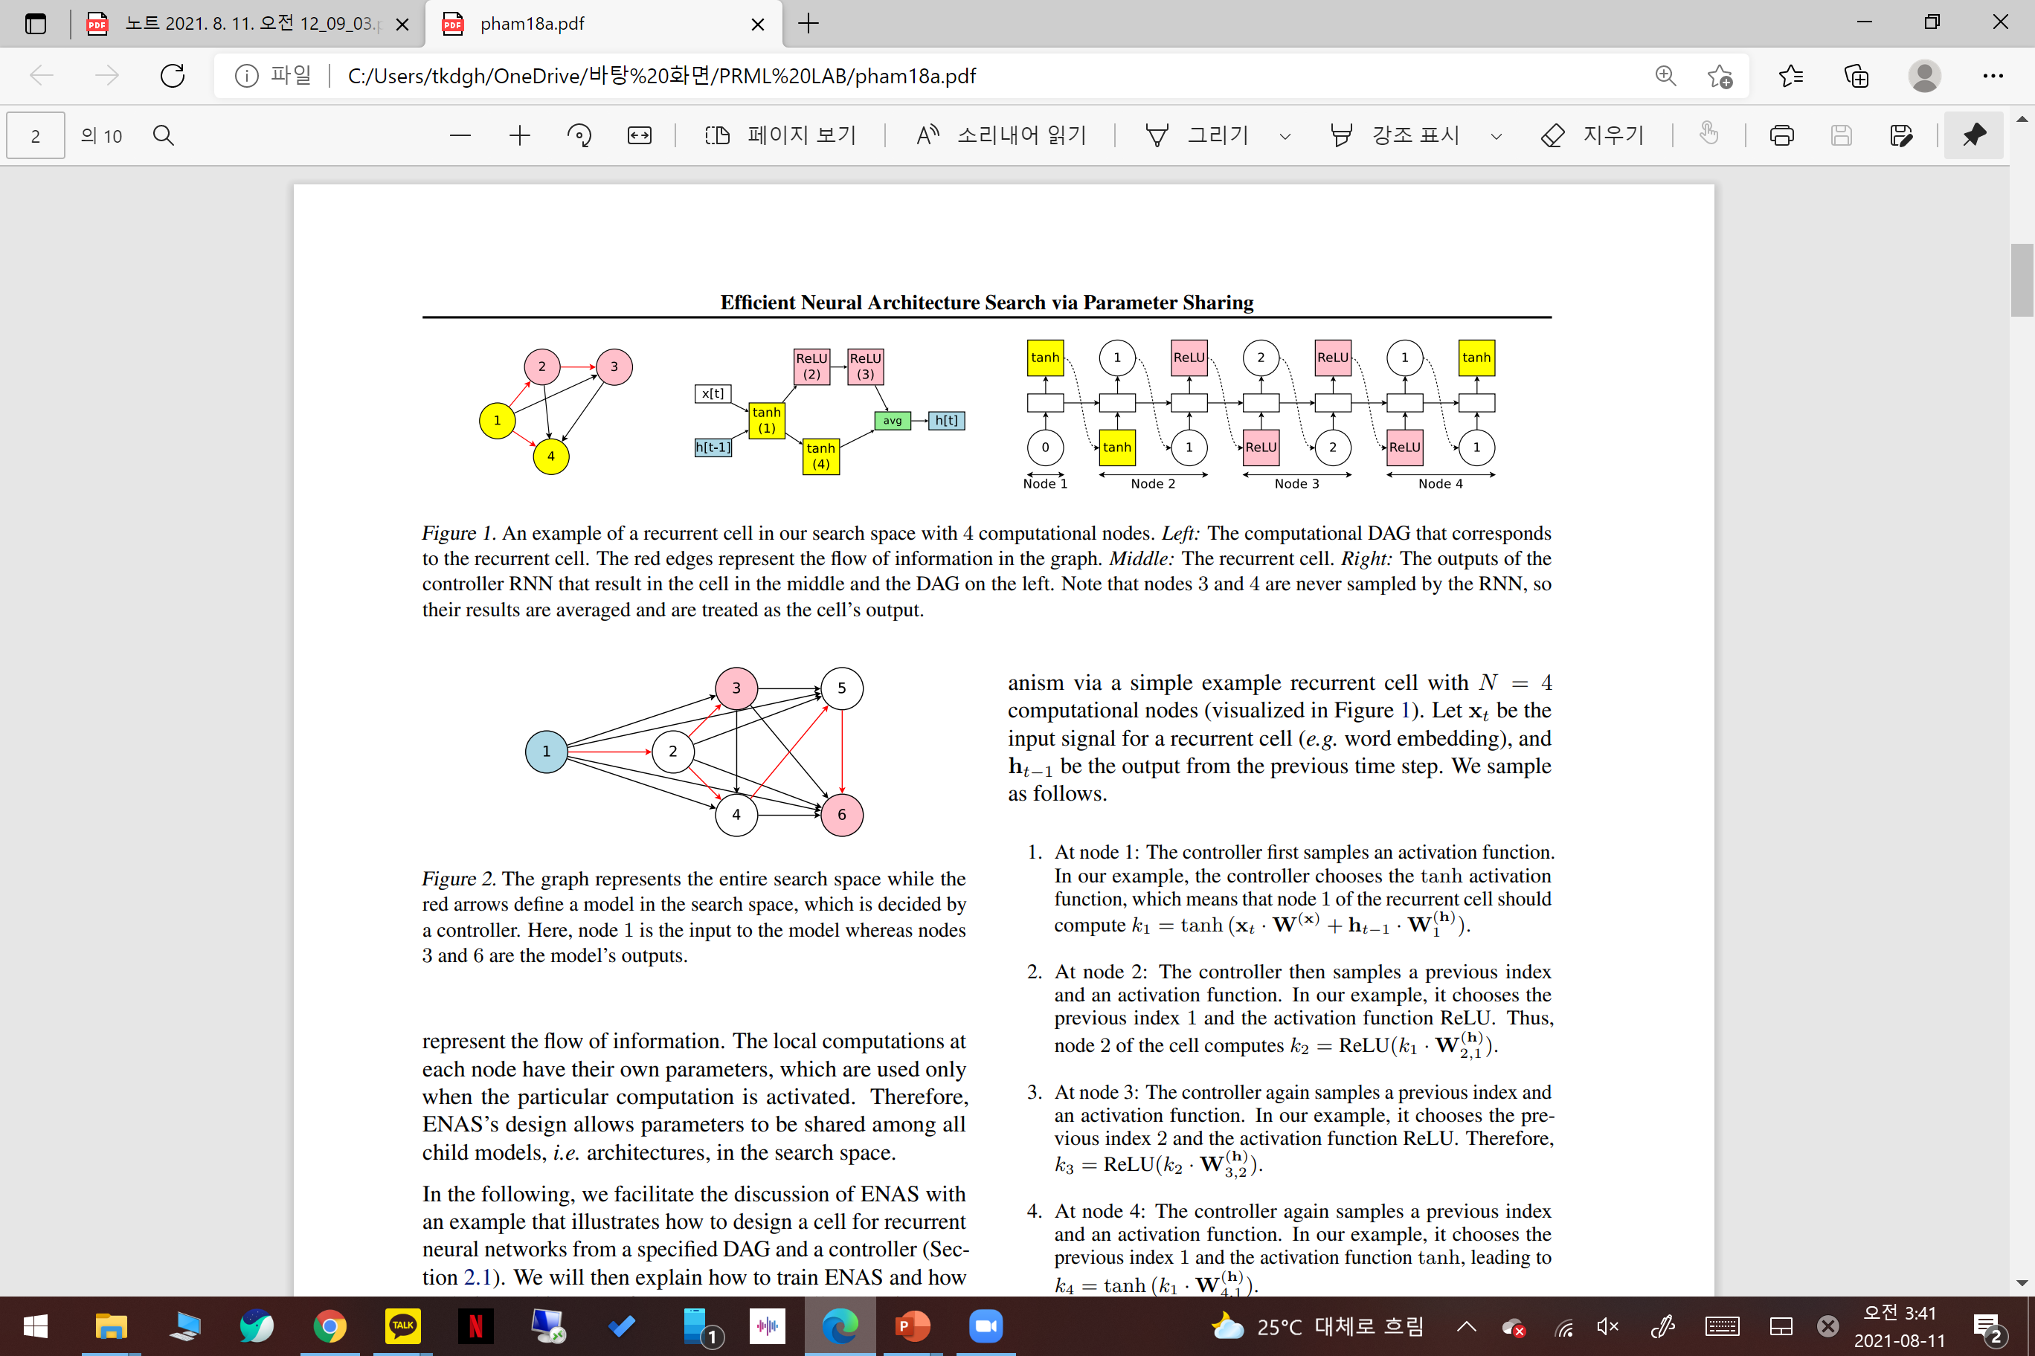
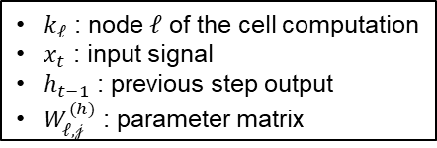
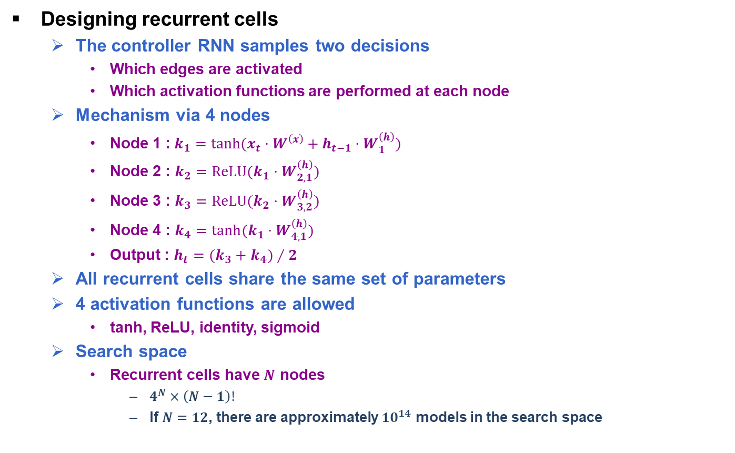
Methods (1/4)
Designing recurrent cells
The controller RNN samples two decisions
Which edges are activated
Which activation functions are performed at each node
Mechanism via 4 nodes
Node 1 :$k_{1}=\tanh{(x_{t}⋅W^{\left(x\right)}+h_{t−1}⋅W_{1}^{\left(h\right)})}$
Node 2 : $k_{2}=\operatorname{ReLU}{(k_{1}⋅W_{2,1}^{\left(h\right)})}$
Node 3 : $k_{3}=\operatorname{ReLU}{(k_{2}⋅W_{3,2}^{\left(h\right)})}$
Node 4 : $k_{4}=\tanh{(k_{1}⋅W_{4,1}^{\left(h\right)})}$
Output : $h_{t}=(k_{3}+k_{4})∕2$
All recurrent cells share the same set of parameters
4 activation functions are allowed
tanh, ReLU, identity, sigmoid
Search space
Recurrent cells have $N$ nodes
$4^{N}×\left(N−1\right)!$
If $N=12$, there are approximately ${10}^{14}$ models in the search space
$k_{𝓁}$ : node $ℓ$ of the cell computation
$x_{t}$ : input signal
$h_{t−1}$ : previous step output
$W_{ℓ,𝒿}^{(h)}$ : parameter matrix
Variable explanation
The DAG of recurrent cells
The recurrent cells
H. Pham, M. Guan, B. Zoph, Q. Le and J. Dean, “Efficient Neural Architecture Search via Parameter Sharing," CLR, 2018.

Slide 5
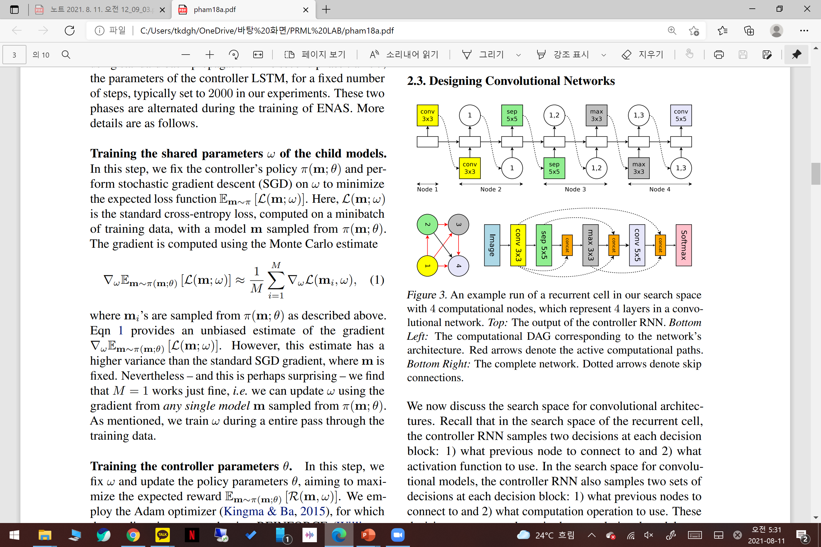
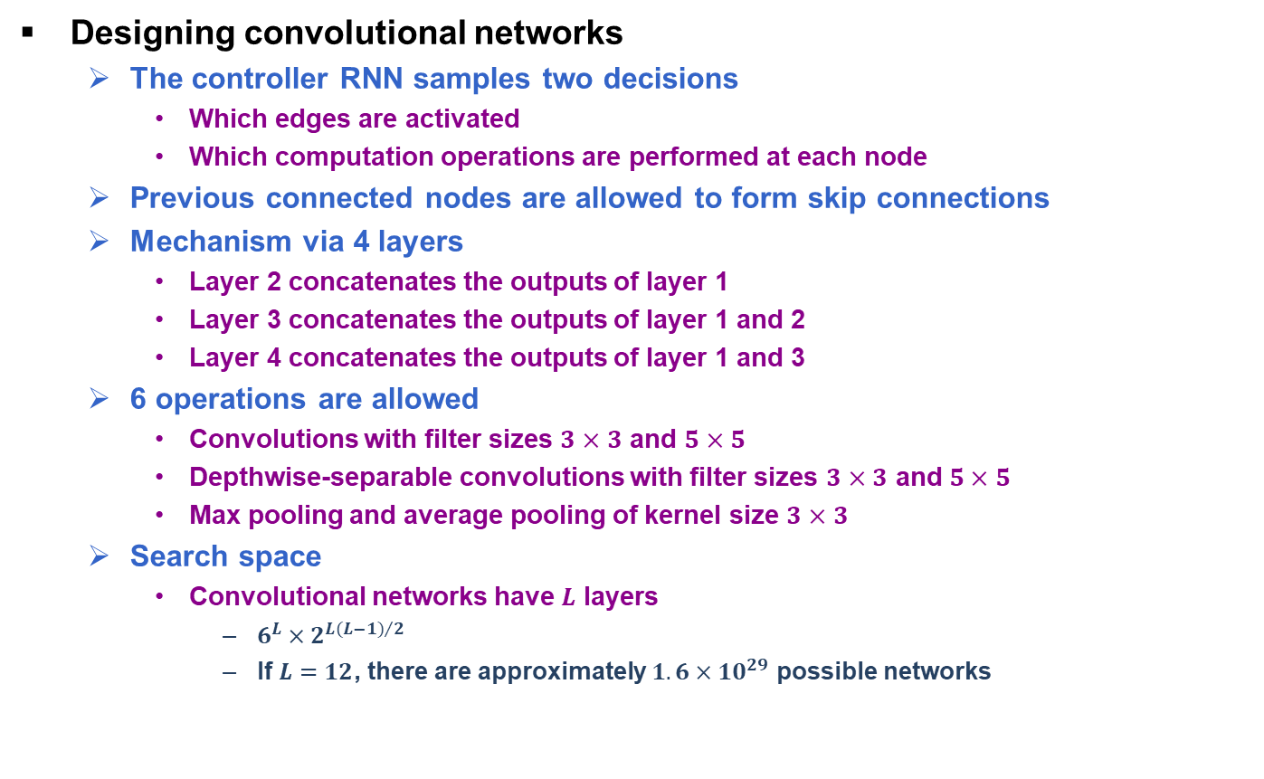
Methods (2/4)
Designing convolutional networks
The controller RNN samples two decisions
Which edges are activated
Which computation operations are performed at each node
Previous connected nodes are allowed to form skip connections
Mechanism via 4 layers
Layer 2 concatenates the outputs of layer 1
Layer 3 concatenates the outputs of layer 1 and 2
Layer 4 concatenates the outputs of layer 1 and 3
6 operations are allowed
Convolutions with filter sizes $3×3$ and $5×5$
Depthwise-separable convolutions with filter sizes $3×3$ and $5×5$
Max pooling and average pooling of kernel size $3×3$
Search space
Convolutional networks have $L$ layers
$6^{L}×2^{{L(L−1)}/2}$
If $L=12$, there are approximately $1.6×{10}^{29}$ possible networks
The complete network
The DAG of network’s architecture
H. Pham, M. Guan, B. Zoph, Q. Le and J. Dean, “Efficient Neural Architecture Search via Parameter Sharing," CLR, 2018.

Slide 6
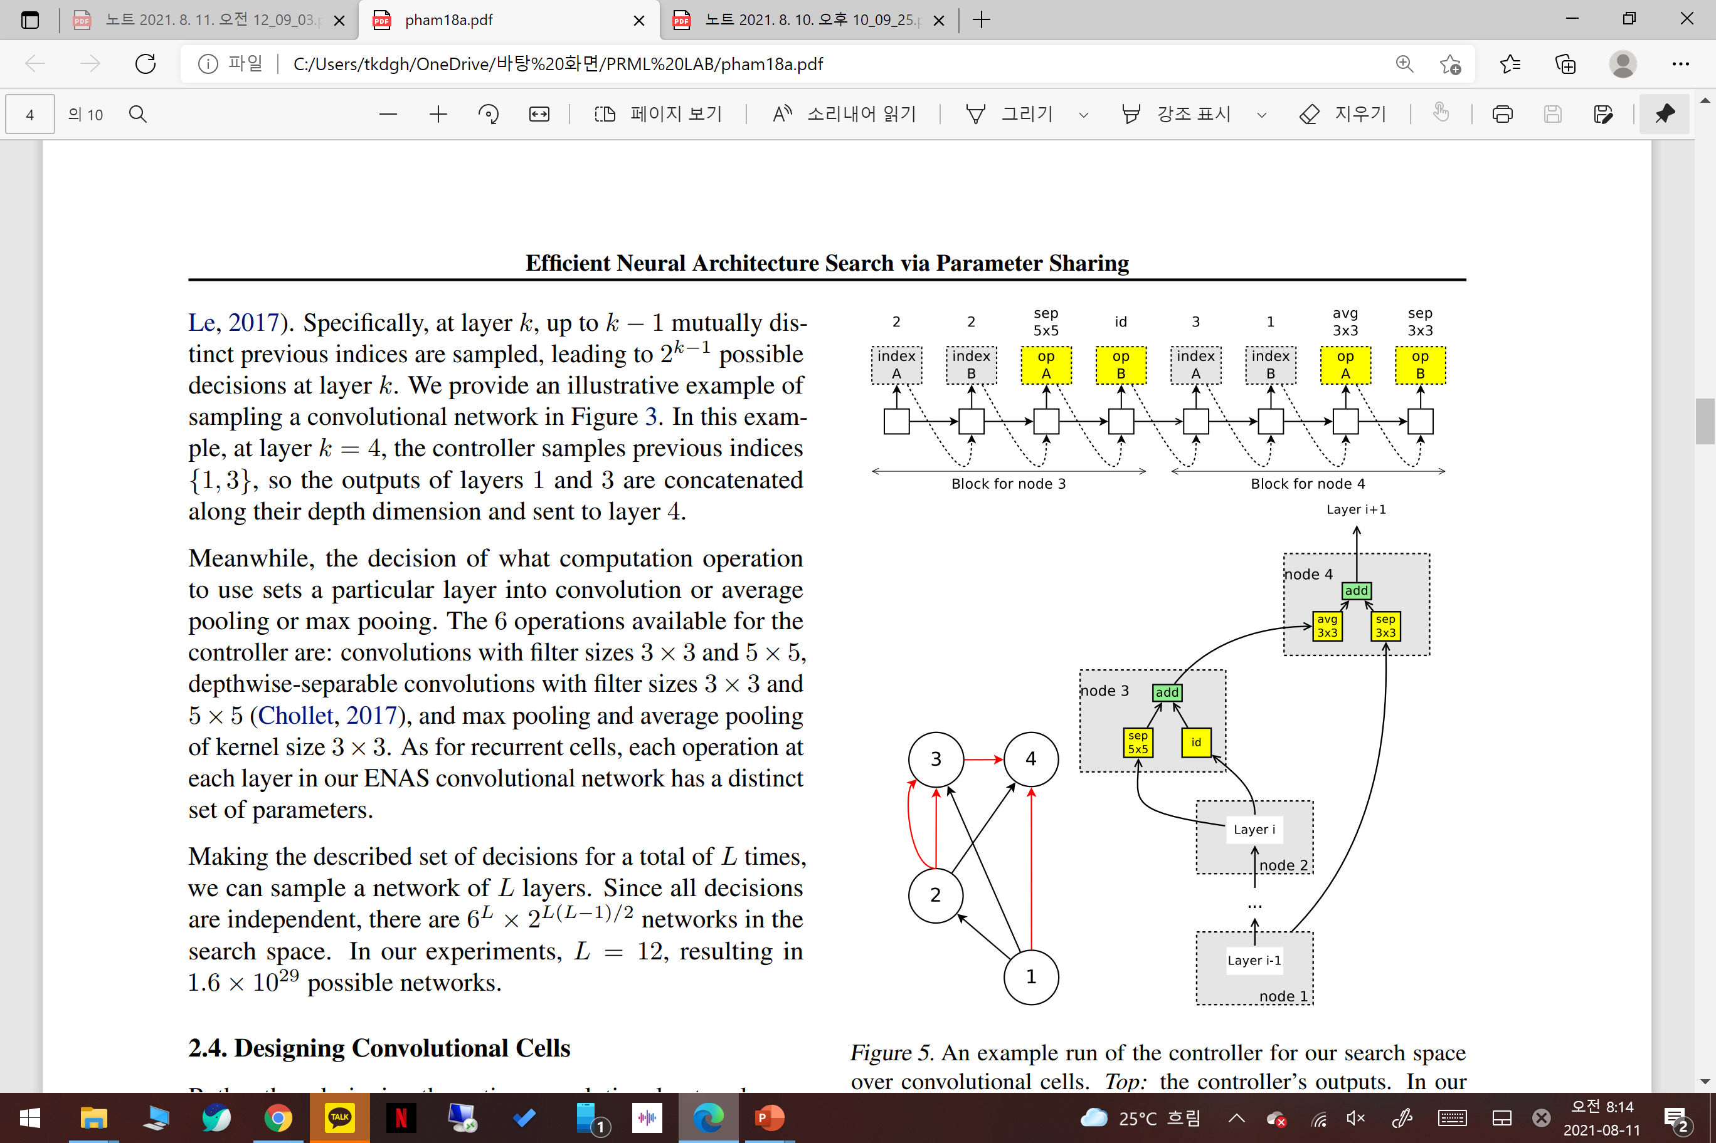
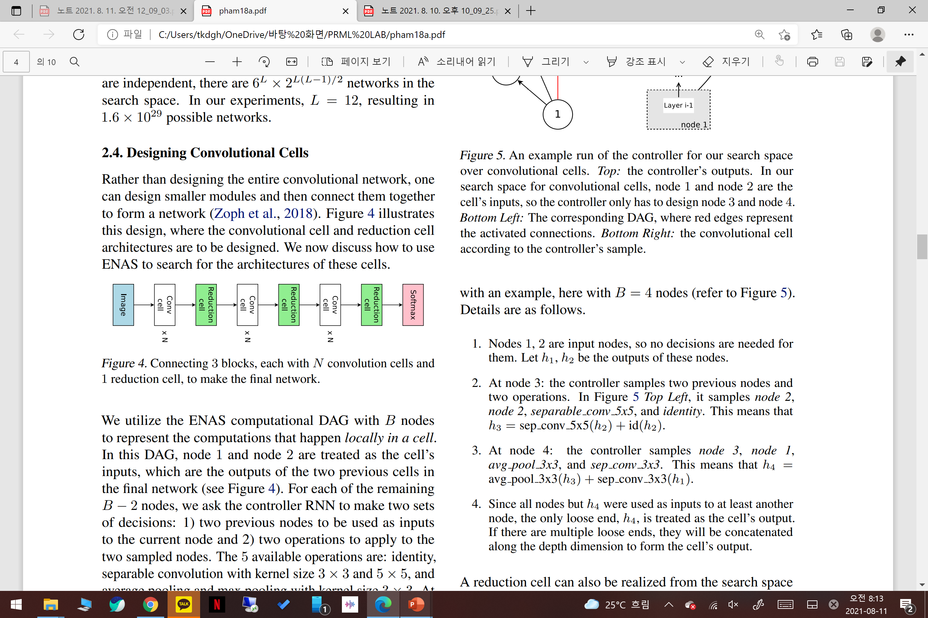
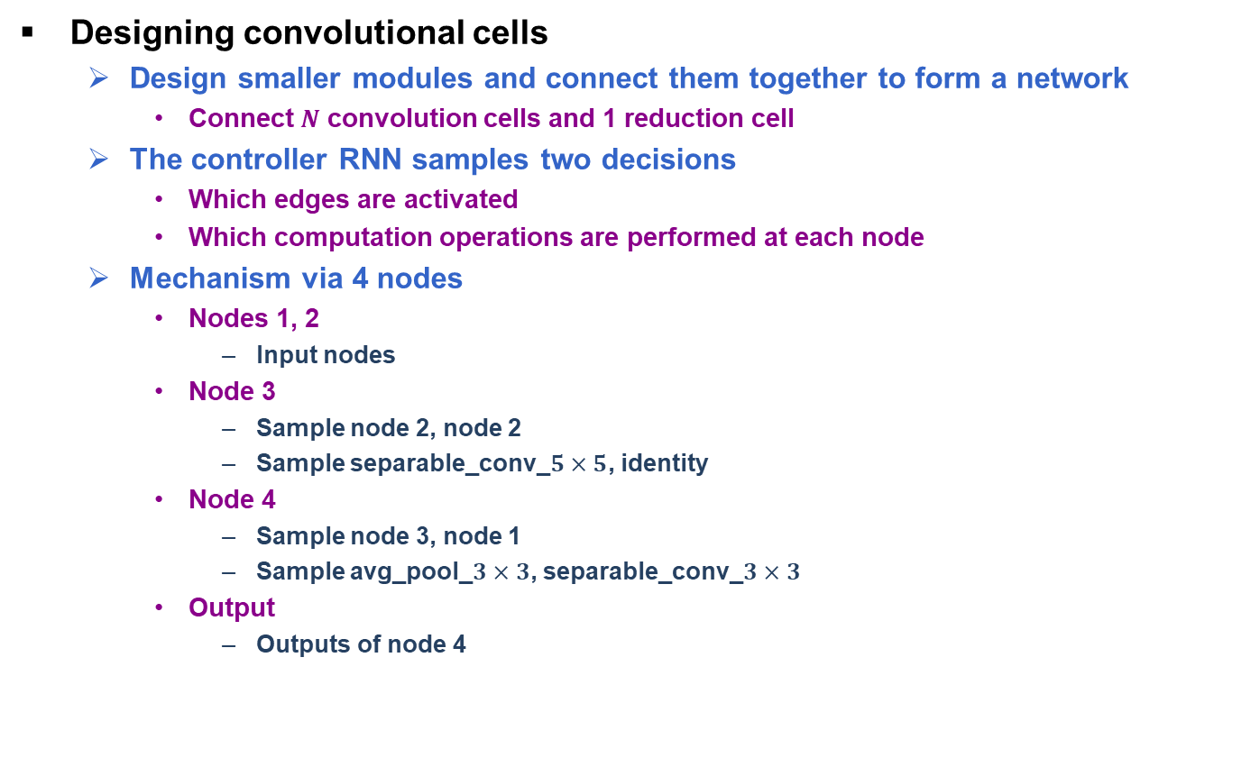
Methods (3/4)
Designing convolutional cells
Design smaller modules and connect them together to form a network
Connect $N$ convolution cells and 1 reduction cell
The controller RNN samples two decisions
Which edges are activated
Which computation operations are performed at each node
Mechanism via 4 nodes
Nodes 1, 2
Input nodes
Node 3
Sample node 2, node 2
Sample separable_conv_$5×5$, identity
Node 4
Sample node 3, node 1
Sample avg_pool_$3×3$, separable_conv_$3×3$
Output
Outputs of node 4
Final network of convolutional cells
The DAG of convolutional cells
The convolutional cell
H. Pham, M. Guan, B. Zoph, Q. Le and J. Dean, “Efficient Neural Architecture Search via Parameter Sharing," CLR, 2018.

Slide 7
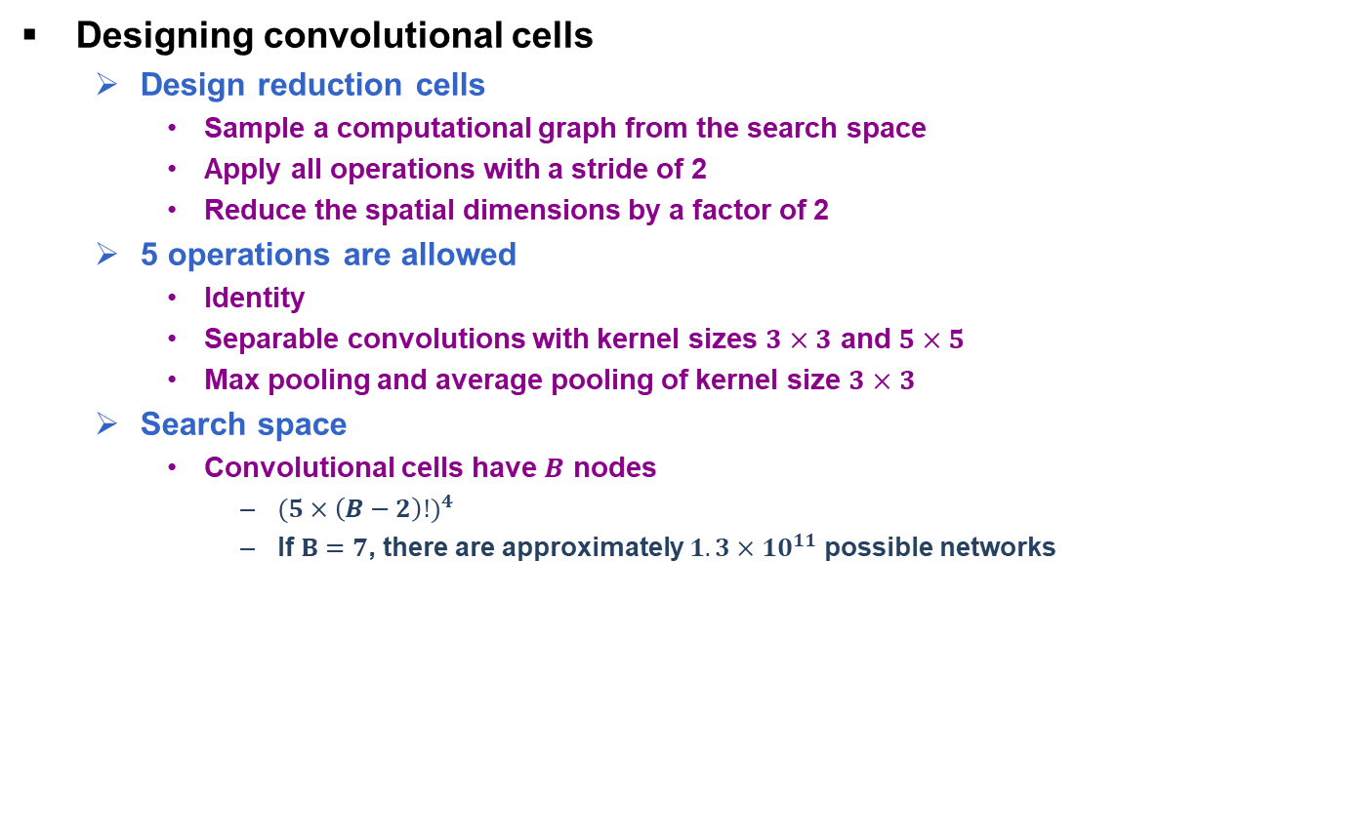
Methods (4/4)
Designing convolutional cells
Design reduction cells
Sample a computational graph from the search space
Apply all operations with a stride of 2
Reduce the spatial dimensions by a factor of 2
5 operations are allowed
Identity
Separable convolutions with kernel sizes $3×3$ and $5×5$
Max pooling and average pooling of kernel size $3×3$
Search space
Convolutional cells have $B$ nodes
${(5×\left(B−2\right)!)}^{4}$
If $B=7$, there are approximately $1.3×{10}^{11}$ possible networks
H. Pham, M. Guan, B. Zoph, Q. Le and J. Dean, “Efficient Neural Architecture Search via Parameter Sharing," CLR, 2018.

Slide 8
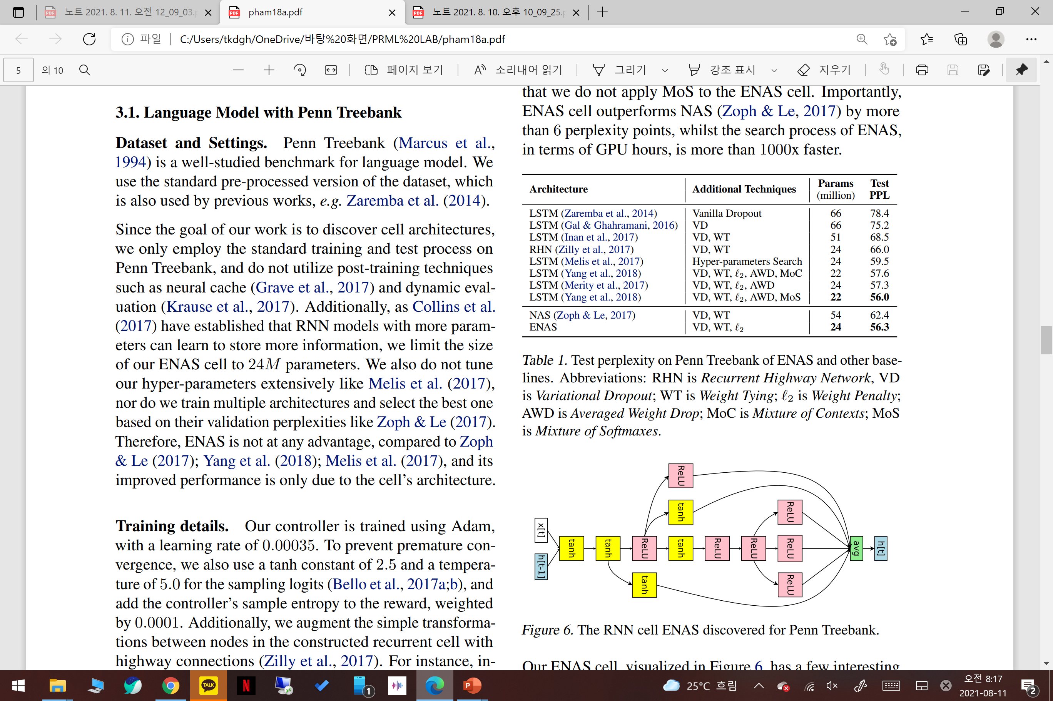
Experiments (1/3)
Recurrent cells on the Penn Treebank
Running on a single Nvidia GTX 1080Ti GPU
ENAS finds a recurrent cell in about 10 hours
Achieves a test perplexity of 56.3, which is on par with SOTA of 56.0
ENAS outperforms NAS by more than 6 perplexity points
ENAS is more than 1000 times faster than NAS in terms of GPU time
The perplexity on Penn Treebank of ENAS
The RNN cell ENAS discovered for Penn Treebank
H. Pham, M. Guan, B. Zoph, Q. Le and J. Dean, “Efficient Neural Architecture Search via Parameter Sharing," CLR, 2018.

Slide 9
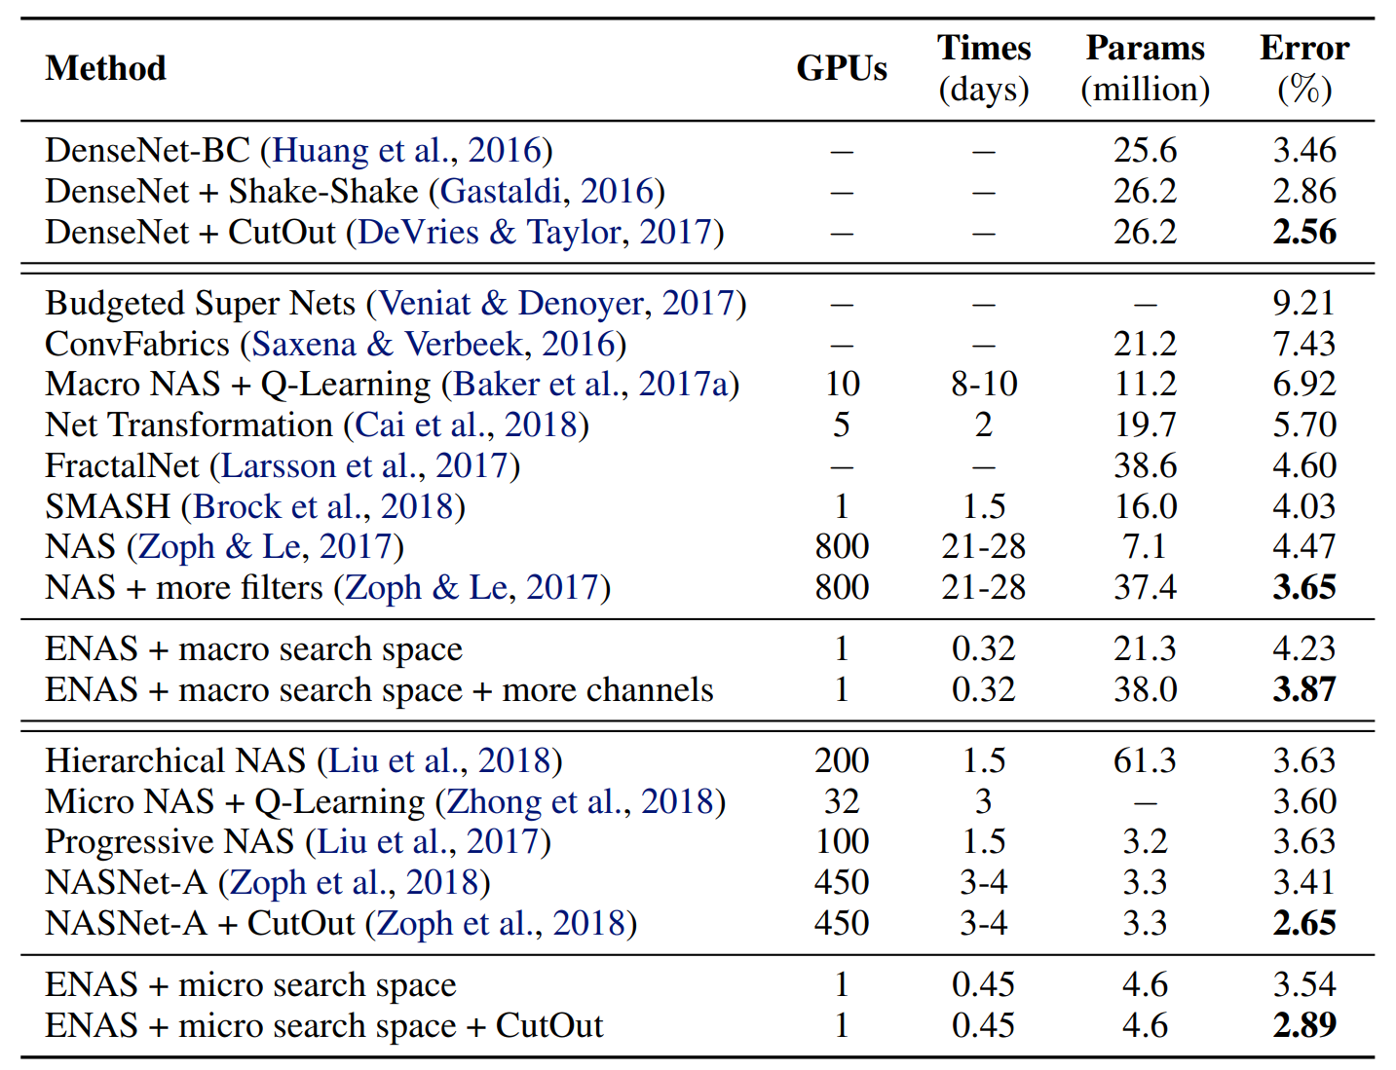
Experiments (2/3)
Convolutional architecture on the CIFAR-10
Entire convolutional networks
Increasing the number of filters in ENAS shows an error rate of 3.87%, not far from the error rate of the NAS's highest model, 3.65%
ENAS reduce the number of GPU-hours by more than 50,000 times compared to NAS.
Convolutional cells
ENAS with cutout achieves to 2.89% test error, on par with the 2.65% by NASNet-A with cutout
Classification errors of ENAS and baselines on CIFAR-10
H. Pham, M. Guan, B. Zoph, Q. Le and J. Dean, “Efficient Neural Architecture Search via Parameter Sharing," CLR, 2018.

Slide 10
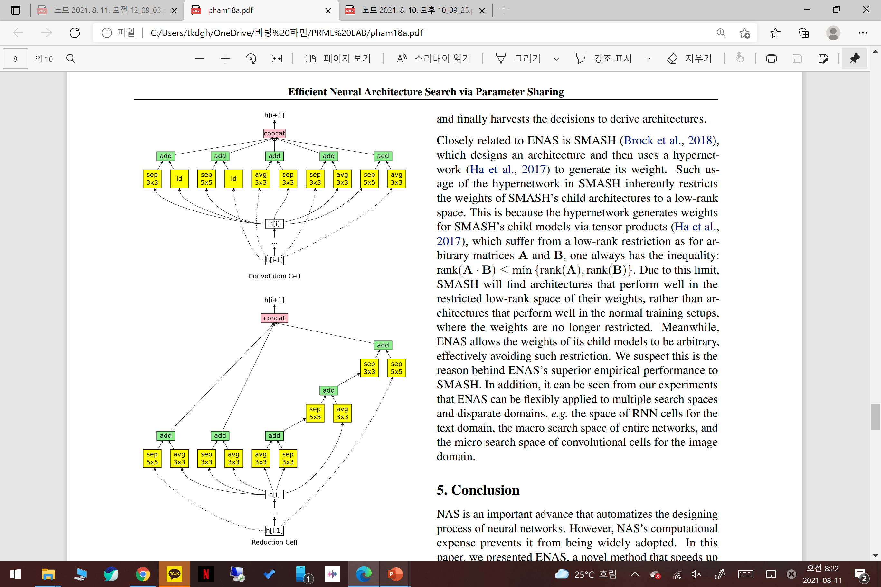
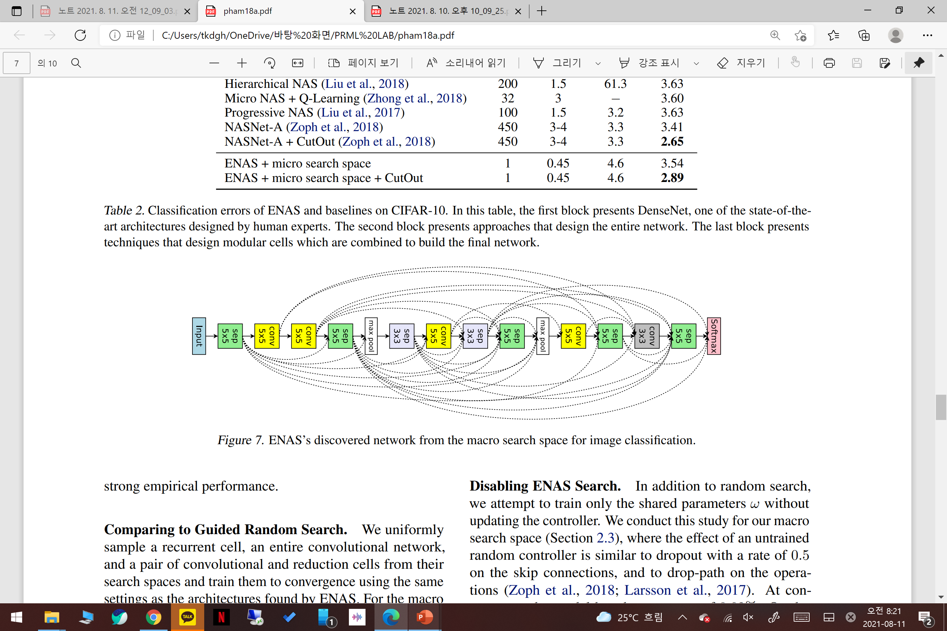
Experiments (3/3)
Convolutional architecture on the CIFAR-10
The convolutional network ENAS discovered for CIFAR-10
The convolutional cells ENAS discovered for CIFAR-10
H. Pham, M. Guan, B. Zoph, Q. Le and J. Dean, “Efficient Neural Architecture Search via Parameter Sharing," CLR, 2018.

